Slide 1

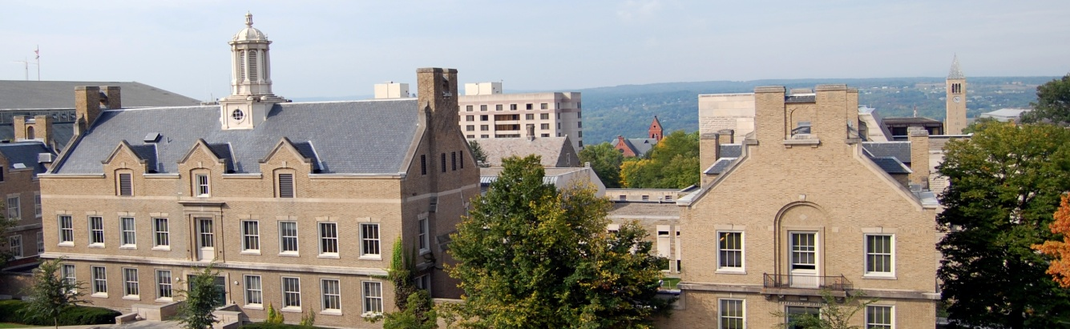
Worker Rights, Labor Law, and Dispute Resolution with the Global Supply Chain in Asia
An ILR Student Symposium
October 6, 2016

Slide 2
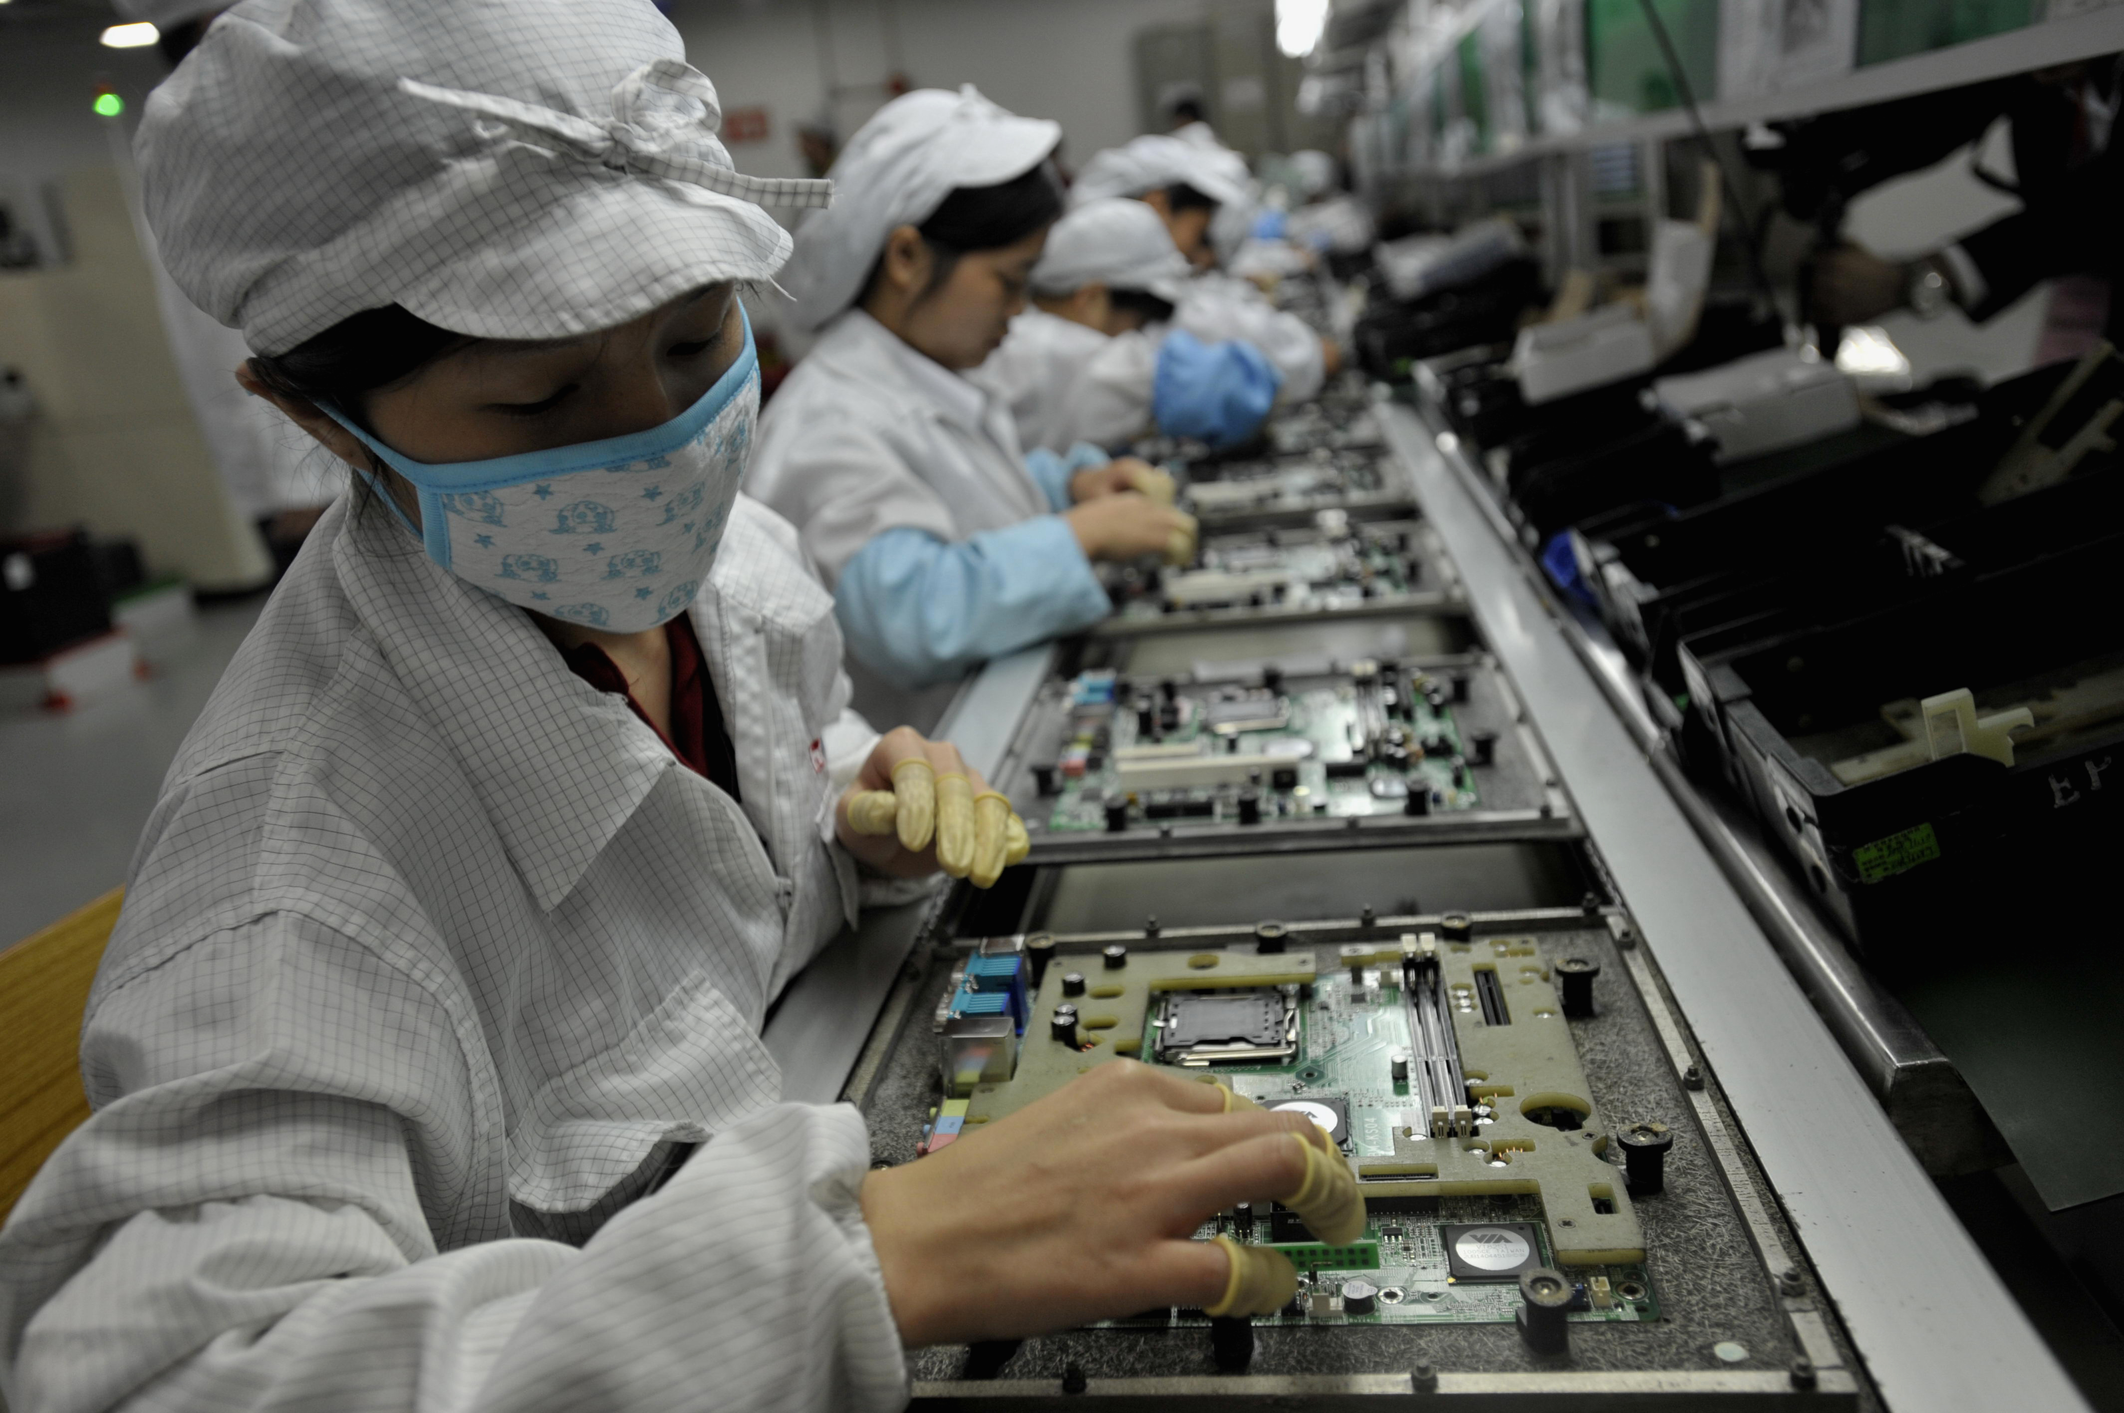
Labor Rights in the Malaysian Electronics Industry & TPP
Marc Masson
BSILR ‘17

Slide 3
What impact can TPP have on labor rights in Malaysian electronics?
Malaysia has historically stalled international efforts to guarantee collective bargaining rights in its electronics industry
Since 1998, the industry has relied on low-skilled, poorly paid foreign workers on short-term contracts at high risk of falling into situations of forced labor
Notes:
Forced labour refers to situations in which persons are coerced to work through the use of violence or intimidation, or by more subtle means such as accumulated debt, retention of identity papers or threats of denunciation to immigration authorities.

Slide 4
Core International Labor Standards
ILO C098 - Right to Organize and Collective Bargaining Convention, 1949 (No. 98)
In 1992, Malaysia's Prime Minister threatened to denounce Convention No. 98 and leave the ILO
ILO C105 - Abolition of Forced Labor Convention, 1957 (No. 105)
Denounced by Malaysia in 1990

Slide 5
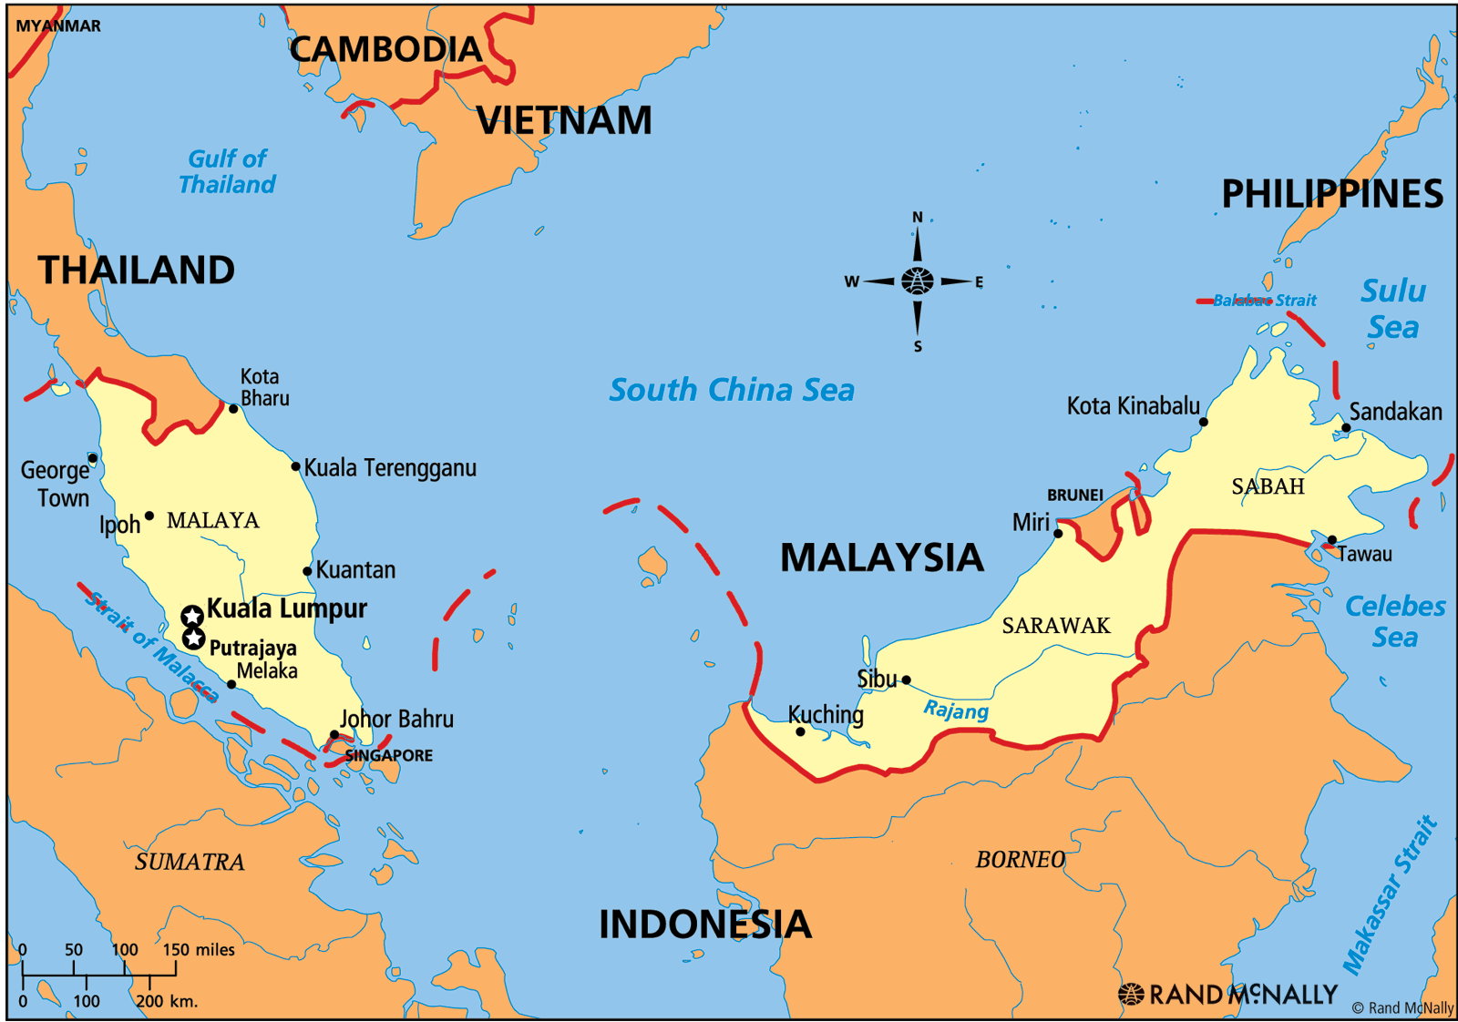

Slide 6
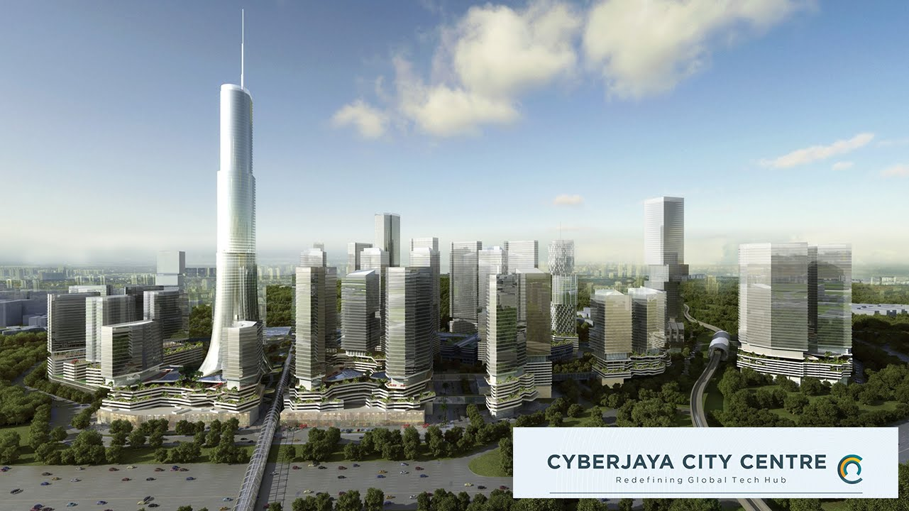
Notes:
CyberJaya, on the outskirts of Putrjaya, is the symbol of Malaysia’s aspiration to become a leader in global electronics.

Slide 7
Anti-Union Policies
Historically, the Malaysian government implemented policies that made unionization of electronics workers difficult to keep wages competitive for MNCs.
In the electronics sector, unions were banned. Although the ban on electronics unions was lifted in 1988, electronics workers were not permitted to affiliate themselves with national or industry level federations.
Notes:
Workplace industrial relations in a developing environment: barriers to renewal within unions in Malaysia, by Kumar, Lucio, and Rose http://onlinelibrary.wiley.com/doi/10.1111/j.1744-7941.2012.00053.x/epdf
LINKAGES BETWEEN INDUSTRIALIZATION STRATEGIES AND INDUSTRIAL RELATIONS/ HUMAN RESOURCE POLICIES: SINGAPORE, MALAYSIA, THE PHILIPPINES, AND INDIA SAROSH KURUVILLA* Kuruvilla

Slide 8
Signs of Progress
Introduction of the minimum wage in 2012
Regional unions allowed in 2010
Pressure from industrialized countries to form a national electronics industry union
However, unionization in “pioneer” industries like electronics remains difficult
TPP Malaysia-US Side Agreement
Notes:
Economic implications of ASEAN integration for Malaysia’s labour market, Rajah Rasiah
http://ilo.org/wcmsp5/groups/public/---asia/---ro-bangkok/documents/publication/wcms_323002.pdf
http://www.aflcio.org/Blog/Political-Action-Legislation/With-Malaysia-Upgrade-Administration-Puts-TPP-Agenda-Ahead-of-Trafficking-Victims-and-Workers-Rights
“Malaysia’s stance on trade unions may be changing, following the introduction of the minimum wage in 2012 and the pressure imposed by some industrialized countries to formalize efforts to form a national union in the electronics industry.” P. 10

Slide 9
The Malaysia-US TPP Side Agreement
The agreement limits the Malaysian government’s ability to restrict union formation in the following areas:
Government discretion in registering trade unions
Government discretion to cancel trade union registration
Cancellation of registration when two or more unions exist
Discretion to suspend a union
Restrictions on formation of unions in “similar” trades, occupations or industries
Restrictions on formation of, and affiliation with, union federations or confederations in “similar” trades, occupations or industries
Affiliation with international unions
Trade union leadership
Collective bargaining
Strikes
Penal sanctions for peaceful strikes
Notes:
Trade union rights and forced migration are important issues that characterize Malaysia, which led the US to demand a side-agreement in those areas in addition to the general provisions of the TPP

Slide 10
The Electronics Labor Force
After 1998, many Malaysian workers stopped applying for jobs in electronics factories because the wages were too low
The Government allowed manufacturers to resume foreign worker recruitment
As a result, the industry has relied on low-skilled, poorly paid foreign workers on short-term contracts
Of the nearly 300,000 employees in the sector, 70 to 80 percent are women
Notes:
Economic implications of ASEAN integration for Malaysia’s labour market, Rajah Rasiah
http://ilo.org/wcmsp5/groups/public/---asia/---ro-bangkok/documents/publication/wcms_323002.pdf
http://electronicswatch.org/migration-in-a-digital-age_3542.pdf
one of the biggest challenges for the trade union was to organise young female workers: “Young women were reluctant to join the union because they were afraid that union engagement would lead to sanctions by the management. “
Malaysia is a paternalistic society where male managers dominate female workers

Slide 11
Forced Labor
(Sept. 17, 2014 | New York Times)
“The monitoring group, Verité […] found that 32 percent of the industry’s nearly 200,000 migrant workers were employed in forced situations”
“92 percent of migrant workers […] paid recruitment fees” and 92 percent of that group paid recruitment fees exceeding legal or industry standards
Notes:
http://www.nytimes.com/2014/09/17/business/international/report-cites-forced-labor-in-malaysia.html
http://www.verite.org/research/electronicsmalaysia
Verite said that they migrant workers were in situations of forced labor because their passports had been taken away or because they were straining to pay back illegally high recruitment fees.”

Slide 12
The Malaysia-US TPP Side Agreement
The agreement commits the Malaysian government to address forced labor in the following areas:
Protections against the withholding of passports
Foreign worker recruitment practices, contracts and fees
Trafficking and forced labor victim protection services
Foreign worker housing and freedom of movement
The TPP mandates the government to target employers and recruitment agencies who abuse foreign workers.
But how will results be accurately measured? And what will this change if the only the government has agreed to implement their laws?

Slide 13
Critics are Not Convinced
"Malaysia is a very corrupt place where those with connections and money can get away with not complying with the law”
Phil Robertson, Deputy Director for Asia at Human Rights Watch
"Given that they get everything they want upfront whether they change anything or not (not an ideal negotiating strategy), the labor enforcement provisions are so weak there isn't a stick to force them to comply.”
Said McGill, International Labor Rights Forum
Notes:
http://www.politifact.com/global-news/statements/2016/apr/12/bernie-s/sanders-right-migrant-laborers-malaysia-are-forced/

Slide 14
Human Rights Watch’s Assessment
“While the Consistency Plans require implementation of legal reforms, enforcement of labor laws, and general institutional capacity building, gauging compliance will require subjective assessments by the US that may take years to carry out and face obstacles arising from foreign policy objectives, commercial interests, and other political considerations.”
(Human Rights Watch, 2016)
Notes:
https://www.hrw.org/news/2016/01/12/qa-trans-pacific-partnership#4

Slide 15
Weak Results in the Past
Malaysia began changing its labor policies in response to international pressure
However, “the Western focus on resolving only basic rights violations (and the needs of their MNCs) undermined union campaigns, leading to reprisals against workers […];
The prospect for unionization, at least among US electronics employers, is poor and the willingness and intensity with which they will fight unionization clearly established.” (Bhopal et al, 2002)
Notes:
http://www.academia.edu/15176874/The_State_in_employment_the_case_of_Malaysian_electronics (p1182) by Mhinder Bhopal

Slide 16
What can we expect from TPP?
Although the current TPP appears to effectively to limit Malaysian government’s ability to curtail unionization, it will likely have a limited impact in its electronics industry
The industry is heavily dominated by migrant (women) workers, who are much more vulnerable than Malaysian workers to employer coercion and dependent on wages to pay back their recruitment fees

Slide 17
What can we expect from TPP?
Government anti-union policy was the major barriers to unionization in the past, but today it is the high prevalence of precarious foreign workers in the electronics industry
Government corruption and cost-competition for MNCs sourcing from Malaysia makes guaranteeing labor rights for electronics workers difficult without a strong labor union

Slide 18
Policy Recommendations
TPP must do more to ensure that Malaysian workers can report situations of abuse, and not just through governmental enforcement
Working with reputation-conscious MNCs and the MTUC, an independent factory monitoring authority should be established
TPP should oblige the Malaysian government to support non-governmental mechanisms for protecting electronics workers

Slide 19
Noted Gaps in Current Research
What is the capacity of the MTUC to report and combat workplace rights abuses?
How can women and foreign workers in Malaysia become better integrated into the labor movement?
Has public pressure on electronics MNCs by NGOs led to changes in labor practices?
Notes:
What are the main challenges to organising workers in this sector? You have to know the culture and the religion. Thirty years ago I never saw a female Muslim wearing a scarf, but this changed with Islamization. Nowadays, many women stay away from men, so only other women can talk to them about union and labour rights. Moreover, Malaysia is a very paternalistic society. There is a great degree of male dominance over women, which begins at home and continues at the factories where female workers are dominated by the male supervisors. Women are not supposed to lead, but expected to follow. That’s why they are reluctant to stand up for their rights. This makes it difficult to involve them in union organising.

Slide 20
Conclusion

Slide 21
Questions?

Slide 22
Bibliography
Asia Monitor Resource Center. "Trading Labor Rights in Malaysia." Trading Labor Rights in Malaysia. October 1992. Accessed October 06, 2016. http://www.multinationalmonitor.org/hyper/issues/1992/10/mm1092_11.html.
Greenhouse, Steven. "Report Cites Forced Labor in Malaysia’s Electronics Industry." The New York Times. September 17, 2014. Accessed October 06, 2016. http://www.nytimes.com/2014/09/17/business/international/report-cites-forced-labor-in-malaysia.html.
Leong, Trinna. "'Forced Labor' Rife in Malaysian Electronics Factories: Report." Reuters. September 17, 2014. Accessed October 06, 2016. http://www.reuters.com/article/us-malaysia-labour-report-idUSKBN0HC08E20140917.
Bhopal, Mhinder, and Chris Rowley. "The State in Employment: The Case of Malaysian Electronics." The International Journal of Human Resource Management 13, no. 8 (2002): 1166-185. doi:10.1080/09585190210149466.
Rasiah, Rajah. "Economic Implications of ASEAN Integration for Malaysia’s Labour Market." International Labor Organisation, November 2014. http://ilo.org/wcmsp5/groups/public/---asia/---ro-bangkok/documents/publication/wcms_323002.pdf.
Kumar, Naresh, Miguel Martinez Lucio, and Raduan Che Rose. "Workplace Industrial Relations in a Developing Environment: Barriers to Renewal within Unions in Malaysia." Asia Pacific Journal of Human Resources 51, no. 1 (2012): 22-44. doi:10.1111/j.1744-7941.2012.00053.x.
Kuruvilla, S. "Linkages between Industrialization Strategies and Industrial Relations/Human Resource Policies: Singapore, Malaysia, the Philippines, and India." ILR Review 49, no. 4 (1996): 635-57. doi:10.1177/001979399604900404.
Rahim, Rohani Abdul, Muhammad Afiq Bin Ahmad Tajuddin, Kamaruddin Bin Hj. Abu Bakar, and Mohammad Nizamuddin Bin Abdul Rahim. "Migrant Labour and Issues on Outsourcing System in Malaysia." SHS Web of Conferences 18 (2015): 01003. doi:10.1051/shsconf/20151801003.
Bormann, Sarah, Pathma Krishnan, and Monika Neuner. "Migrant Workers in the Malaysian Electronics Industry: Case Studies on Jabil Circuit and Flextronics." World Economy, Ecology and Development, December 2010. http://electronicswatch.org/migration-in-a-digital-age_3542.pdf.

